Slide 1
Energy Harvesting Using Piezoelectric Technology on Roads
Presented by:
Eco Riders
Team Members:
1.Kabilan N
2.Krishnaprasath A S
3.Gowtham S

Slide 2

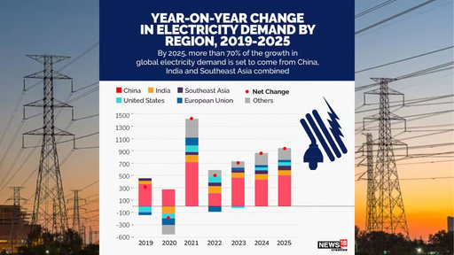
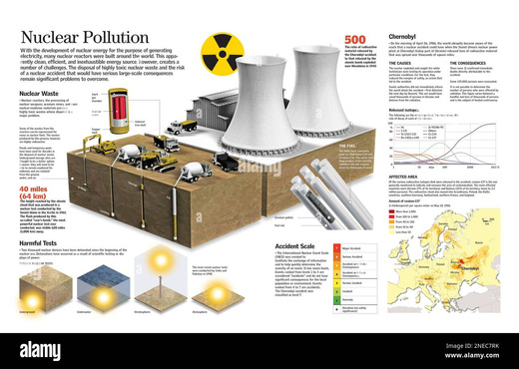
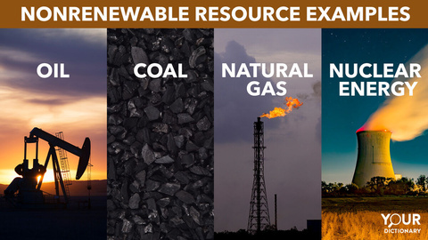
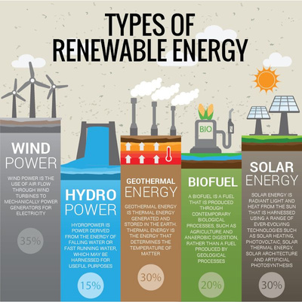

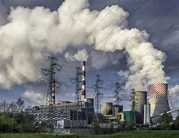
Problem Statement
Electricity demand is increasing rapidly worldwide
Electricity demand is increasing rapidly worldwide, placing a heavy burden on conventional fossil fuel–based power generation. Coal, oil, and natural gas–powered plants emit large amounts of carbon dioxide and other pollutants, accelerating climate change and harming public health. Additionally, fossil fuel reserves are limited, leading to rising costs
Renewable energy sources such as solar, wind, hydro, and biomass can generate electricity without depleting resources or producing harmful emissions. The shift toward renewable electricity is needed.

Slide 3

Abstract
Our project focus on producing electricity from roads using piezoelectric sensors. Piezoelectric materials generate electric charge when pressure is applied to them. By combining these sensors under road surfaces, the pressure from moving vehicles can be converted into electrical energy. This renewable energy can be stored in batteries or used to power streetlights, traffic signals, and other public utilities. The method is eco-friendly, and makes use of existing road infrastructure. This technology can help in creating smarter and more sustainable cities. This technology not only supports environmental sustainability but also contributes to smart city development by integrating energy generation into transportation networks. By harnessing wasted mechanical energy from roads, piezoelectric road systems can help reduce dependence on another source of electricity and more energy-efficient future.

Slide 4

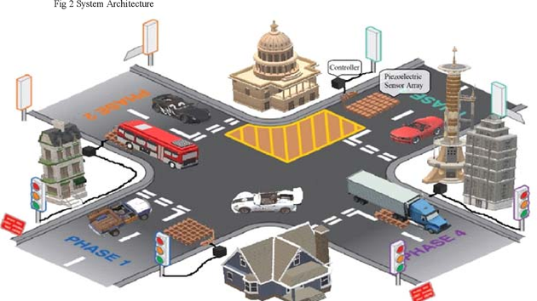
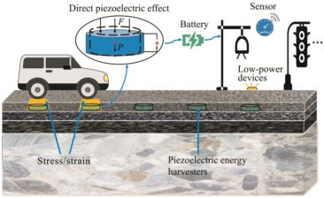
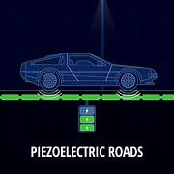
Solution
Implement piezoelectric sensors beneath road surfaces to capture mechanical pressure from moving vehicles.
Convert this pressure into electrical energy using piezoelectric materials.
Store the generated electricity in batteries or supply it directly to public utilities such as: Streetlights, Traffic signals, Roadside billboards.
Utilize existing road infrastructure — no need for entirely new setups.
Eco-friendly & renewable — zero emissions during energy generation.
Harvest wasted mechanical energy from vehicle movement for sustainable power generation.

Slide 5

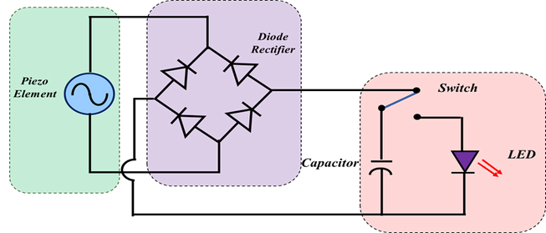
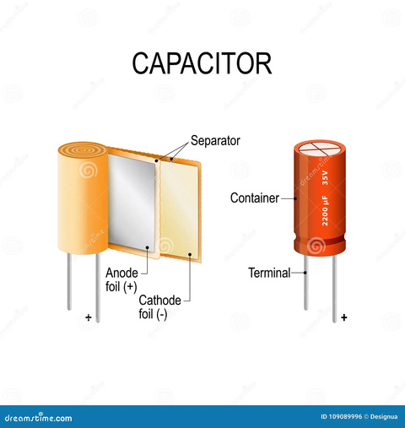
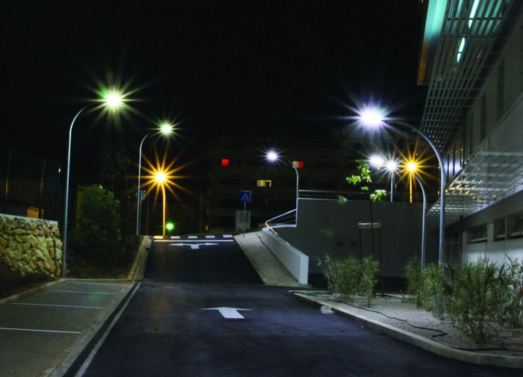
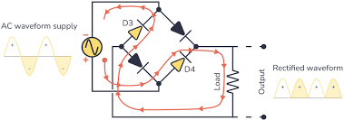
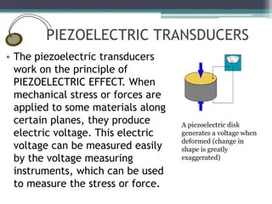
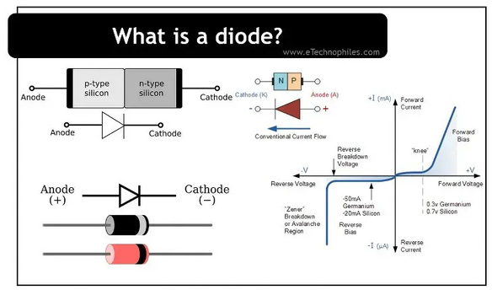
Technical Stack

Slide 6

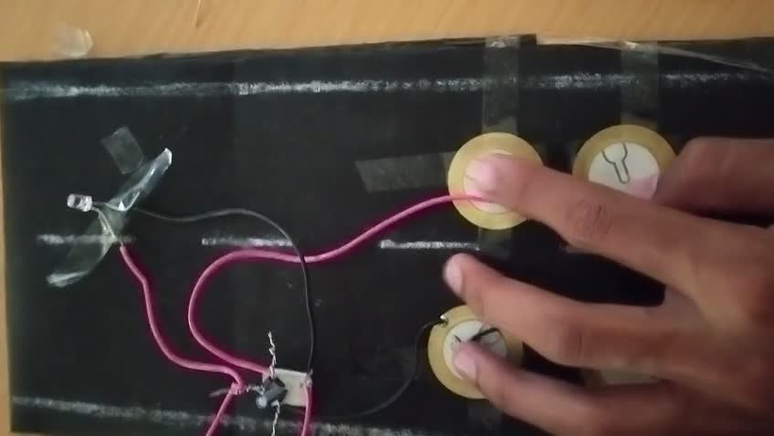
Completion Status & Current Stage
Apply for the pattern we need atleast 4 to 6 month.
To make prototype we 18 to 20 days and for research we need 2 to 2.5 months
we are here now
4
2
4
3
Our project is now at the starting stage. we have only the idea and demo model.
1
For research we need 2 to 2.5 months

Slide 7






Target Market Audience
Government & Municipal Authorities.
Urban infrastructure departments.
Smart city projects.
Renewable energy initiatives.
National highways authorities.
Toll road companies.
Commercial Infrastructure Owners.
Large industrial parks.
Shopping malls with heavy parking traffic.
Educational & Research Institutions.
Market Characteristics
Focused on urban & high-density traffic areas.
Driven by smart city policies and sustainability goals.
High potential in developing nations with expanding infrastructure.

Slide 8


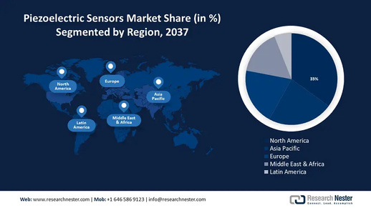

Business Model
Convert road traffic pressure into clean electricity.
Reduce dependency on traditional power sources.
Support smart city & sustainability goals
Utilize existing road infrastructure with minimal disruption.
Direct Sales: Selling piezoelectric road modules to governments & contractors.
Energy Sales: Supplying generated electricity to the grid or public utilities.
Service Contracts: Maintenance & performance monitoring.
Partnerships: Collaborations with smart city and renewable energy projects.
Value Proposition
Revenue Streams

Slide 9



